Slide 1


Explainability techniques for Graph Neural Networks
Aniket Saxena
IBM Research, India

Slide 2
Introduction
Graph Explainability techniques involve finding the smallest possible subgraph of the original graph (feed as input to Graph Neural Network (GNN) model), on which when the trained GNN model is applied, gives predictions closer to what it outputs while being trained on the original graph.
This presentation explains several methods recently introduced to thrive explainability in the Graph structural domain as these methods may increase the transparency of applying GNNs for decision-critical applications, such as drug discovery and diagnosis.

Slide 3
Perturbation-based methods
It involves perturbing the input features and monitoring the changes in the final predictions.
It is more of a masking-based method than a dropping-based method.
These methods can further be divided into two categories: node-based masking and edge-based masking.

Slide 4


PGExplainer
PGExplainer is a parameterized explanation method that learns to mask those edges which don’t contribute more to their respective final predictions.
To accomplish this, it uses MLP to learn to generate explanations from the trained GNN model.
PGExplainer uses the following mechanism to compute edge weights:
and
,
Here, is a temperature parameter that is set using the aforementioned annealing schedule.
PGExplainer uses the following cross-entropy-based objective function:

Slide 5
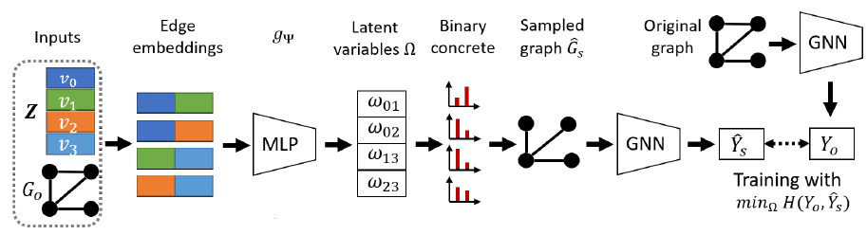
Schematic diagram of PGExplainer

Slide 6
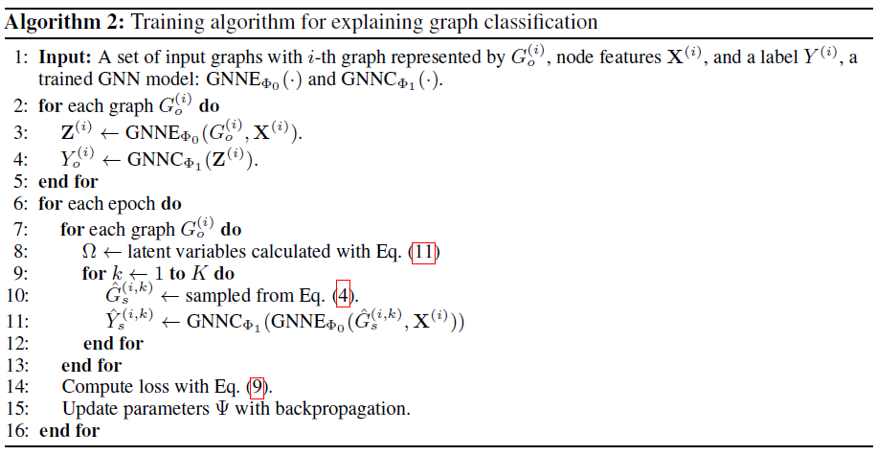

Slide 7




GraphMask
GraphMask can be understood as a differentiable form of subset erasure, where, instead of finding an optimal subset to erase for every given example, we learn an erasure function that predicts for every edge (u, v) at every layer k whether that connection should be retained.
Edge weights can be computed by the following equation:
The objective function for GraphMask is given as:
To make the above cost function continuous everywhere, it can further be converted to expectation:

Slide 8
Limitations of Perturbation-based methods
The important nodes or edges in their explanations are not guaranteed to be connected.
Since GNNs are very complex, node/edge importance cannot be directly converted to subgraph importance.
These methods ignore the interactions among different nodes and edges, which may contain important information.

Slide 9

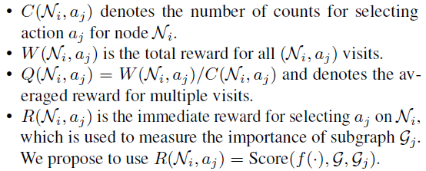
SubGraphX
SubgraphX is a subgraph-based explanation method that learns to explore and identify important subgraphs (graph substructures) from the input graph itself.
The explanation of prediction y for input graph G can be defined as:
SubgraphX uses the MCTS algorithm which records four variables for each node of the search tree:

Slide 10
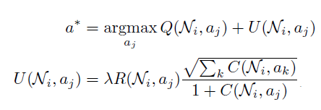

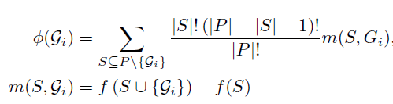


the action selection criteria of node $N_{i}$ are defined as:
All node and action pairs selected in this path are updated as:
The Shapley value of the player Gi can be computed as:
where

Slide 11
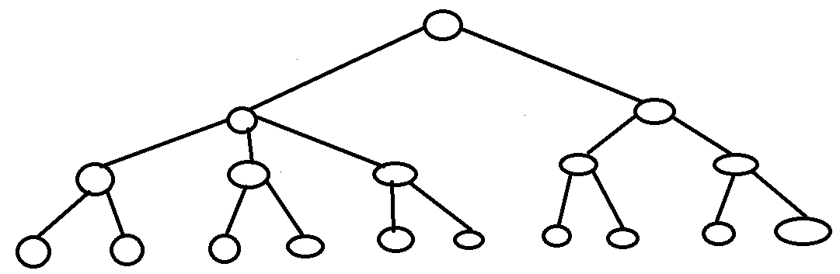


















Schematic example of search tree
$$N_{0}$$
($N_{0}$, $a_{1}$)
($N_{0}$, $a_{2}$)
($N_{1}$, $a_{3}$)
($N_{1}$, $a_{4}$)
($N_{2}$, $a_{6}$)
($N_{2}$, $a_{7}$)
($N_{1}$, $a_{5}$)
($N_{5}$, $a_{12}$)
($N_{6}$, $a_{14}$)
($N_{7}$, $a_{16}$)
($N_{3}$, $a_{9}$)
($N_{4}$, $a_{10}$)
($N_{7}$, $a_{17}$)
($N_{3}$, $a_{8}$)
($N_{5}$, $a_{13}$)
($N_{6}$, $a_{15}$)
($N_{4}$, $a_{11}$)

Slide 12
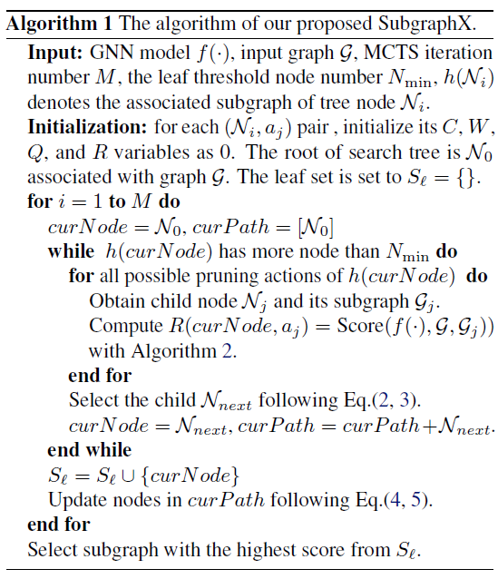
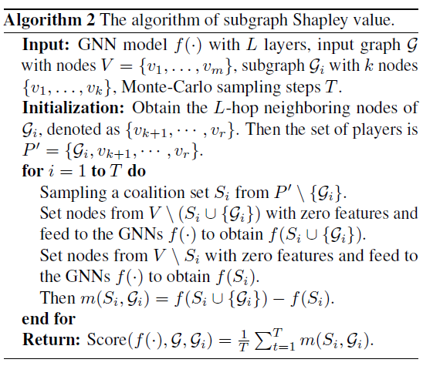

Slide 13
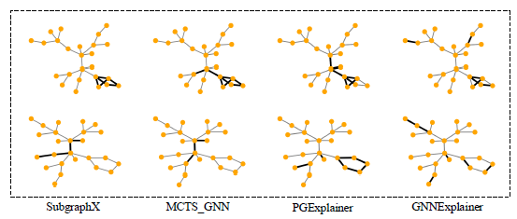
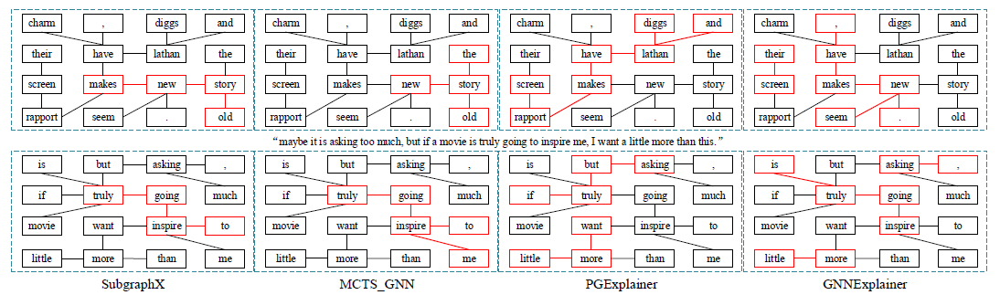
The inconsistencies across methods

Slide 14
